Slide 1

On Becoming a Leader in Risk Management
Fundamentals of RM
RM System and Process
Leadership in RM
Incident investigation
RM Tools & Challenges
RM in Industry
People & Org.
Application and Perspectives
ENGG404 – Lecture
Chapter 3.3: RME #04 Management of Change (MOC)
1
Notes:
ENGG404 Lecture 00 - Day 1
2012 Fall
1
1

Slide 2
Learning Outcomes:
Explain the purpose of a basic Management Of Change (MOC) work process, the manner in which it is used, and the benefits for managing change.
Explain the need to manage change by gaining an appreciation about the potential changes in risk as a change in the activity, the technology of the operation, or organization (structure and people) is made.
Explain the significance of the “Management of Change” element in a Risk Management System.
Apply the basic MOC work process
Chapter 3.3: RME #4 Management of Change
2
Notes:
2

Slide 3
Look at Change in Terms of a Change in Risk Level:
Management needs to look at change in terms of a change in risk level and the consequences of the change:
Does the change introduce a new or different risk? Hazards? Likelihoods? Consequences?
Does the change affect the effectiveness of existing safeguards and control measures? Engineering controls?
Does the change influence administrative controls (procedures) and work practices? New training materials? New or refresher training? New people in new roles?
Chapter 3.3: RME #4 Management of Change
3
Notes:
3

Slide 4
When a change occurs or a change is planned:
Change is an accepted fact of business for all areas of an operation or an organization
Management must ensure their employees:
Understand that change is a normal part of operations.
Have the tools to clarify the scope of change and evaluate it.
Understand the requirements for reviews and for levels of approval.
Change requires appropriate management system oversight to ensure that the change does not introduce new risks, or diminish (change) control measures for existing risks.
Chapter 3.3: RME #4 Management of Change
4
Notes:
4

Slide 5
How is MOC linked to the Risk Management System?
Management Leadership, Commitment and Accountability.
Risk Assessment and Management of Risks.
Community Awareness and Emergency Preparedness.
Management of Change.
Incident Reporting, Investigation, Analysis and Actions.
Program Evaluation and Continuous Improvement.
Design, Construction and Start-up.
Operations and Maintenance.
Employee Competency and Training.
Contractor Competency and Integration.
Operations and Facilities Information and Documentation.
You can expect that everywhere you go in your career the company will have a MOC program. MOC is almost universal.
And if it doesn’t, what are you going to do?
Implement a “Management of Change” Program in areas under your responsibility.
Chapter 3.3: RME #4 Management of Change
5
Notes:
5

Slide 6
Management of Change applies to:
Any kind of change must be considered because a change has the potential to introduce increases in risk and loss exposures.
Scope and Stage: small and large scale projects at all stages (conception-design-construction-operation- maintenance):
Changes beyond well-defined limits (i.e. exceed specifications) require formal MOC reviews.
Both temporary and permanent changes.
Temporary changes can be overlooked or “forgotten”, or accepted as permanent because “it has been successful”
Rigorous implementation of control measures may NOT have been executed along with the temporary change.
Chapter 3.3: RME #4 Management of Change
6
Notes:
6

Slide 7
MOC Applies to…
Modifications/additions to an existing process, system, facility
Changes in design or materials
Changes in engineering controls
Changes in administrative controls (procedures, practices)
Changes in personnel, staff
Does this apply to your team project loss incident? Many loss incidents are the outcome of a change.
Chapter 3.3: RME #4 Management of Change
7

Slide 8
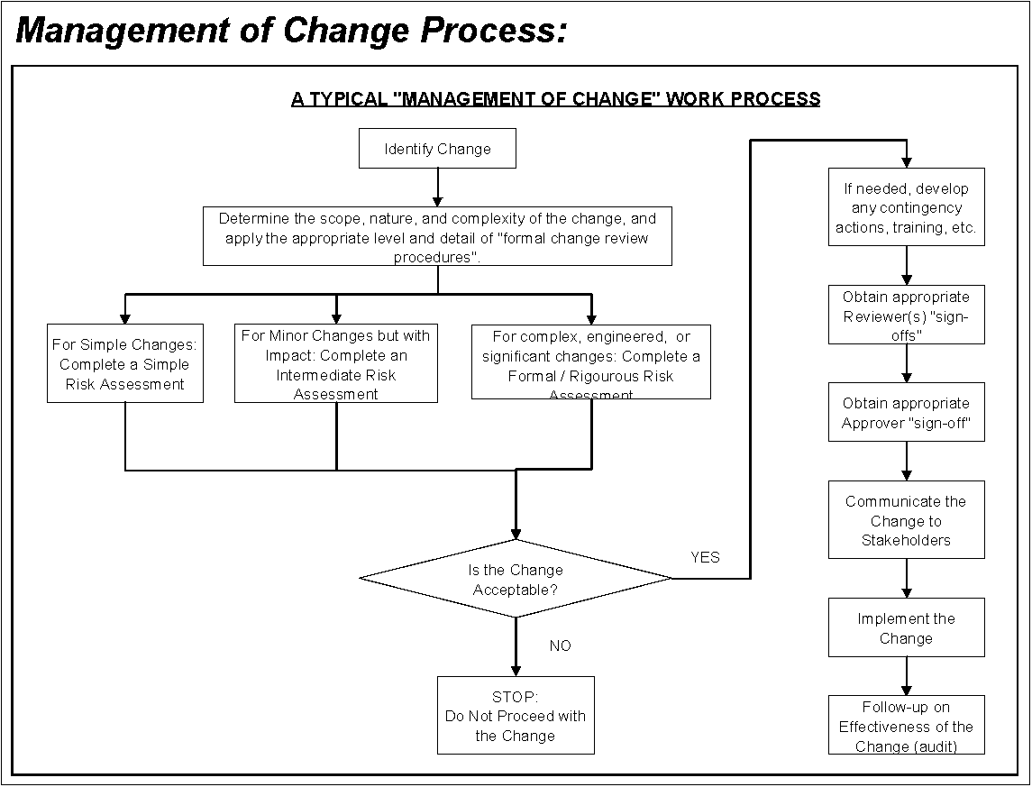
A Typical MOC Work Process:
Communicate (inform) proposed change to stakeholders
Extent of risk review is proportional and commensurate with the change complexity.
Chapter 3.3: RME #4 Management of Change
8
Notes:
8

Slide 9
Who is Responsible for Management of Change?
Several roles involved in managing the change, each becomes involved as the proposed change progresses through the work process. (RACI: Responsible, Accountable, Consulted, Informed)
The Change Owner (Person driving the change): Responsible
The Stakeholders: Informed, Consulted
Subject-matter Experts: Responsible, Consulted, Informed
Managers.
Those affected by or subject to the change.
Those who will implement the change.
Final Approver: Accountable: accountable for ensuring that the MOC work process has been followed.
Chapter 3.3: RME #4 Management of Change
9
Notes:
9

Slide 10
Four Critical Actions for MOC:
Four Actions:
The Change Owner must drive these four actions in MOC:
Every organization may have different procedures for each action
These 4 critical actions are integrated within the MOC WP!
Communicate the Proposed Change
Conduct Appropriate Reviews & Risk Assessments
Seek Final Approval
Communicate & Implement the Change
Chapter 3.3: RME #4 Management of Change
10
Notes:
10

Slide 11
Management of Change is Critical!
The roots of many incidents include the failure to:
Communicate the change;
Conduct appropriate reviews and risk assessments;
Seek and gain final approval;
Implement the change as agreed upon and approved by all stakeholders.
Can weaknesses in the MOC Work Process be latent causes?
Show of hands!
YES?
NO?
NOT SURE?
Chapter 3.3: RME #4 Management of Change
11
Notes:
11

Slide 12
Summary and Key Lesson:
Changes are common occurrences in organizations.
The four critical actions are essential for an effective application of MOC process.
MOC is applicable at every level of the organization and for every change.
Change sets the stage for errors … … and errors lead to loss incidents.
Chapter 3.3: RME #4 Management of Change
12
Notes:
12

